Slide 1
DriverShare Project
Peer-to-Peer Car Rental Platform
A web application that connects car owners with people looking for short-term rentals.
Six Required Design Patterns | Python + Flask + SQLite
By: Maria Aldhaheri

Slide 2
What is DriverShare?
For Car Owners:
Owners can create car listings, change rental prices, update availability, and block dates when their cars cannot be rented.
For Renters:
Renters can search for cars by location and dates, reserve available cars, pay using a demo balance, and watch cars for alerts.
Both users can send messages and receive notifications about bookings, payments, and other updates.

Slide 3
Main Website Features
Registration, login, and password recovery with three security questions
Add and edit car listings, prices, and unavailable dates
Search by location and dates, and prevent overlapping bookings
Reserve a car and make a simulated payment
Watch cars for price or availability alerts
Exchange messages and receive in-app notifications
Implemented as a standalone Flask website with an SQLite database

Slide 4
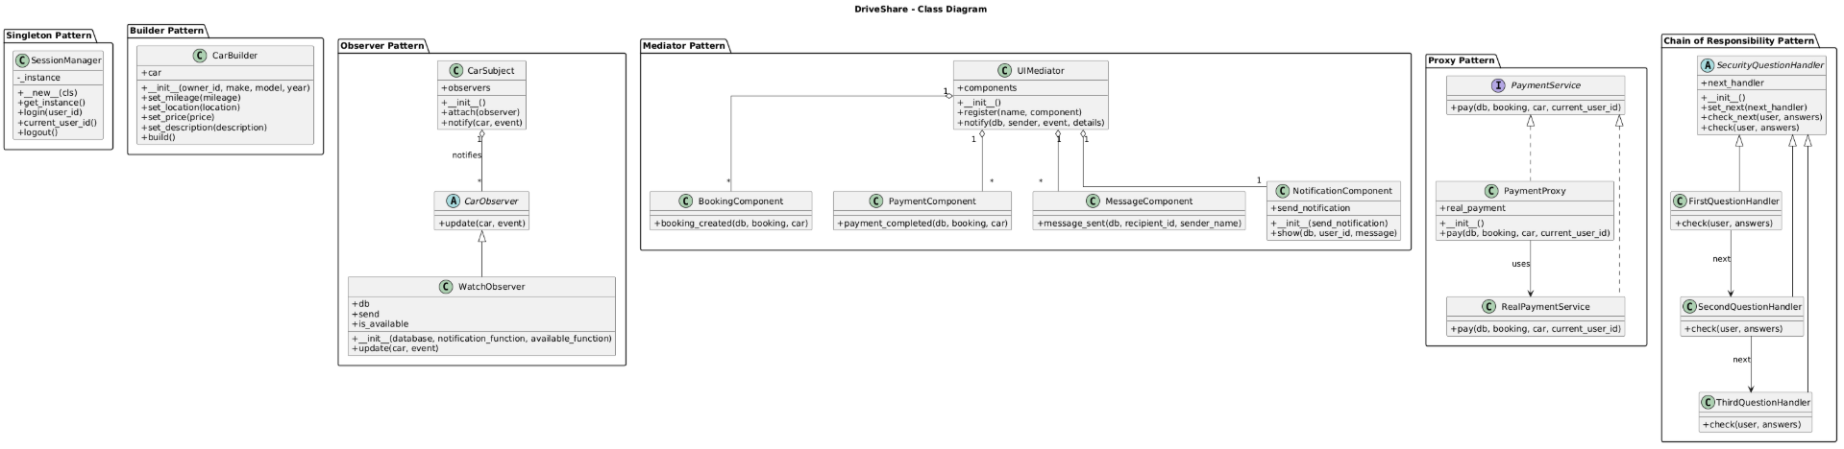
Class Diagram: Six Design Patterns
The class diagram shows how the pattern classes relate to each other in the application.
Notes:
This UML diagram shows the four classes in my Java application and how they work together to clone and customize menu items.

Slide 5
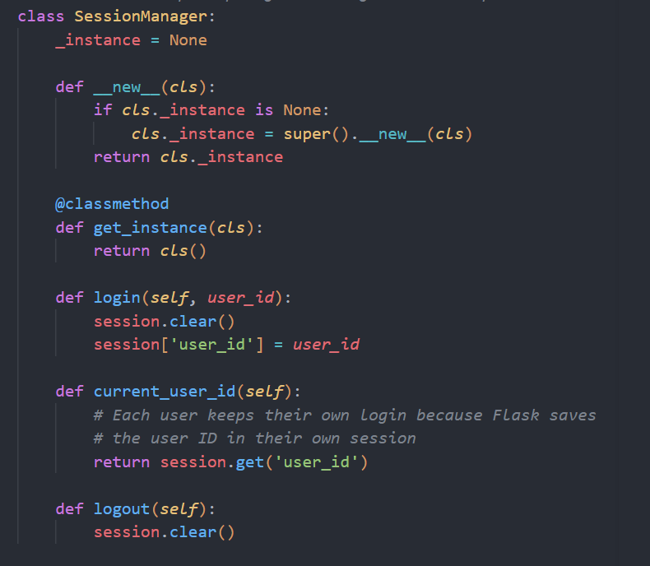
Singleton Pattern
Main Idea:
A Singleton keeps one shared instance of a class.
How DriverShare uses it:
SessionManager manages the current login session using one shared manager. getinstance() returns that same manager.

Slide 6
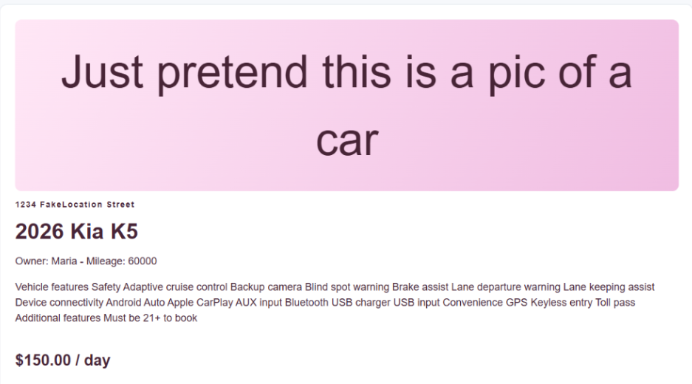
Builder Pattern
Main Idea:
Builder creates an object step by step instead of putting all information into one large constructor.
How DriverShare uses it:
CarBuilder starts with the basic car details, then sets mileage, location, price, and description before build() returns the listing.

Slide 7
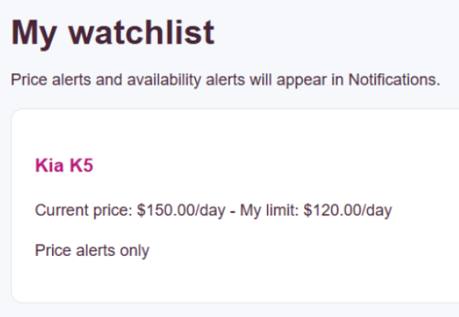
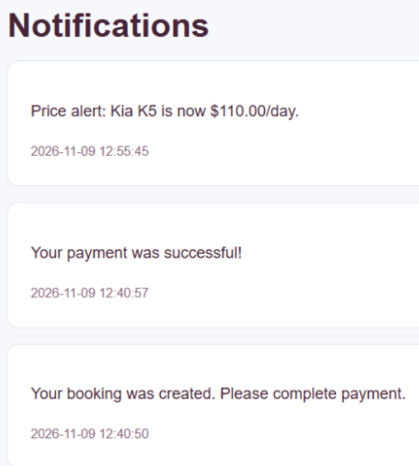
Observer Pattern
Main Idea:
The Observer pattern lets interested objects receive updates when something they are watching changes.
How DriverShare uses it:
CarSubject notifies WatchObserver when a listing changes. The observer checks saved watch conditions and creates a notification if the car matches.

Slide 8
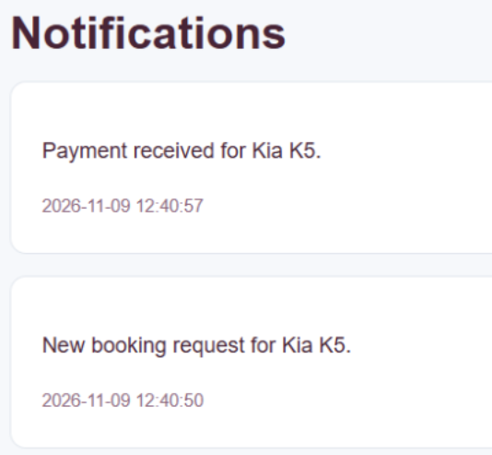
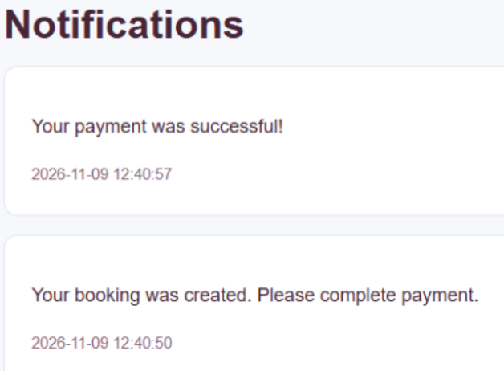
Mediator Pattern
Main Idea:
A mediator helps different components communicate without each component directly controlling the others.
How DriverShare uses it:
UIMediator receives events from booking, payment, and messaging components and sends the appropriate notifications.

Slide 9
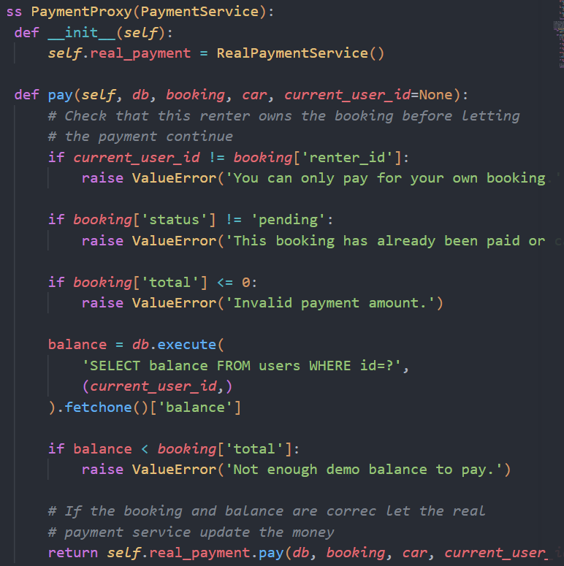
Proxy Pattern
Main Idea:
A Proxy controls access to another service by checking a request before allowing it through.
How DriverShare uses it:
PaymentProxy checks the renter, booking status, total, and available balance. Valid payments go to RealPaymentService, which updates both balances.

Slide 10
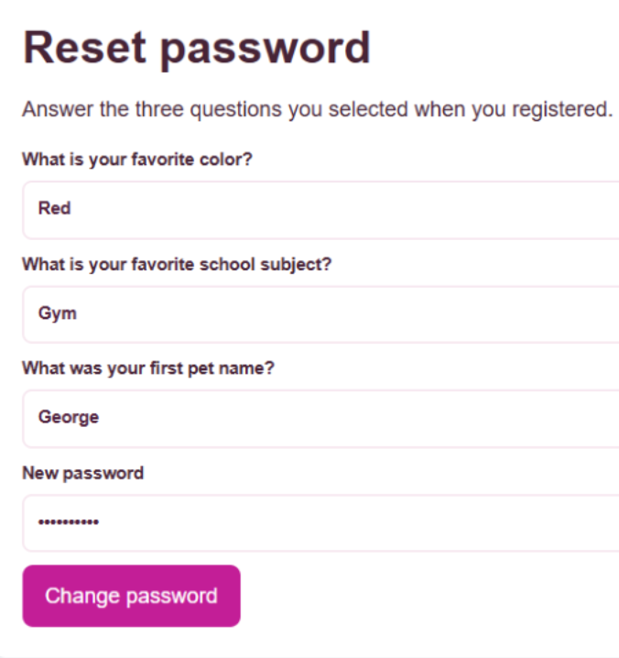
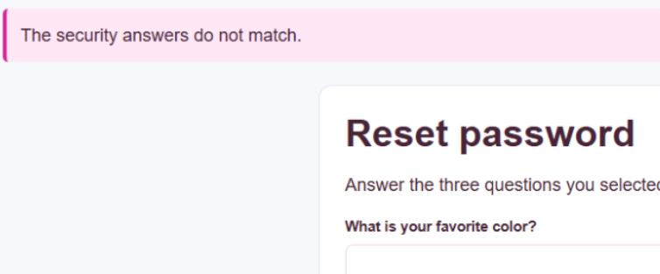
Chain of Responsibility Pattern
Main Idea:
A request passes through a sequence of handlers. Each handler checks its part before the next one continues.
How DriverShare uses it:
FirstQuestionHandler, SecondQuestionHandler, and ThirdQuestionHandler verify the three saved answers. A wrong answer stops recovery.

Slide 11
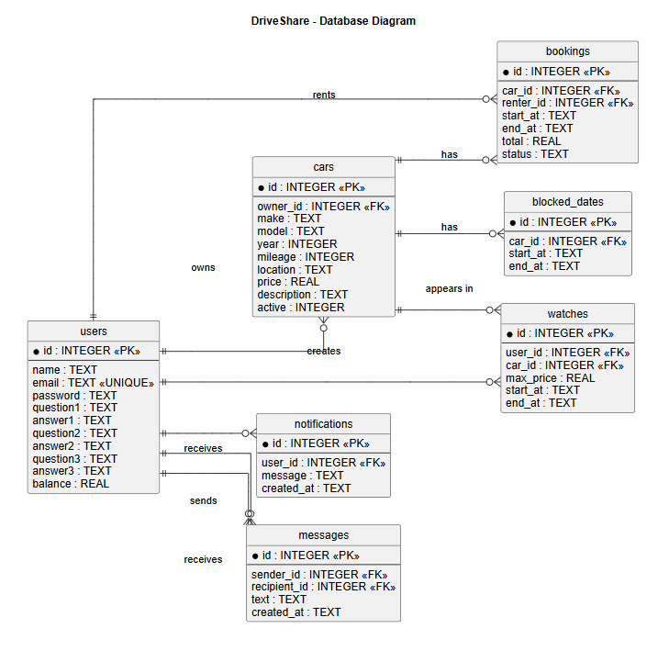
Database Schema
7 tables:
users
cars
blocked_dates
Bookings
Watches
Notifications
Messages
Primary keys identify rows; foreign keys connect users, cars, bookings, and other records.

Slide 12
What the Project Demonstrates
Car owners and renters can complete the main rental workflow.
Booking dates are checked to prevent overlapping rentals.
Demo payments update account balances and send notifications.
The six design patterns organize different parts of the application.
DriveShare combines the required features with the required software design patterns.

Slide 13
References
CIS 476 lecture slides — UML; Singleton & Factory; Facade, Proxy & Chain of Responsibility
GeeksforGeeks — Python Design Patternshttps://www.geeksforgeeks.org/python/python-design-patterns/
GeeksforGeeks — Singleton Method, Pythonhttps://www.geeksforgeeks.org/python/singleton-method-python-design-patterns/
GeeksforGeeks — Proxy Method, Pythonhttps://www.geeksforgeeks.org/python/proxy-method-python-design-patterns/
GeeksforGeeks — Chain of Responsibility Design Patternhttps://www.geeksforgeeks.org/system-design/chain-responsibility-design-pattern/

Slide 14
Link to Presentation

